Slide 1
Modular Programming
Lengthier programs
  Prone to errors
  tedious to locate and correct the errors
To overcome this
Programs broken into a number of smaller logical components, each of which serves a specific task.

Slide 2
Advantages of modularization
Reusability
Debugging is easier
Build library

Slide 3
Functions
A function is a set of instructions to carryout a particular task.
Using functions we can structure our programs in a more modular way.

Slide 4
Functions
Standard functions
(library functions or built in functions)
User-defined functions
  Written by the user(programmer)

Slide 5
Defining a Function
Name
  You should give functions descriptive names
  Same rules as variable names, generally
Return type
  Data type of the value returned to the part of the program that activated (called) the function.
Parameter list
  A list of variables that hold the values being passed to the function
Function body
  Statements enclosed in curly braces that perform the function’s operations(tasks)

Slide 6
The general form of a function definition
return_type function_name( parameter_definition )
{
variable declaration;
statement1;
statement2;
.
.
.
return(value_computed);
}

Slide 7
Functions
Return type
Function name
Parameter List
void DisplayMessage (void)
{
cout << “Hello from the function” ;
}
}
Body
int main()
{
cout << “Hello from main”;
DisplayMessage(); // FUNCTION CALL
cout << “Back in function main again.\n”;
return 0;
}

Slide 8
Functions
Return type
Function name
Parameter List
void DisplayMessage(void)
{
cout << “Hello from the function” ;
}
}
Body
int main()
{
cout << “Hello from main”;
DisplayMessage(); // FUNCTION CALL
cout << “Back in function main again.\n”;
return 0;
}

Slide 9
Functions
Return type
Function name
Parameter List
void DisplayMessage(void)
{
cout << “Hello from the function” ;
}
}
Body
int main()
{
cout << “Hello from main”;
DisplayMessage(); // FUNCTION CALL
cout << “Back in function main again.\n”;
return 0;
}

Slide 10
Functions
Return type
Function name
Parameter List
void DisplayMessage(void)
{
cout << “Hello from the function” ;
}
}
Body
int main()
{
cout << “Hello from main”;
DisplayMessage(); // FUNCTION CALL
cout << “Back in function main again.\n”;
return 0;
}

Slide 11
Functions
Return type
Function name
Parameter List
void DisplayMessage(void)
{
cout << “Hello from the function” ;
}
}
Body
int main()
{
cout << “Hello from main”;
DisplayMessage(); // FUNCTION CALL
cout << “Back in function main again.\n”;
return 0;
}

Slide 12
Functions
Return type
Function name
Parameter List
void DisplayMessage(void)
{
cout << “Hello from the function” ;
}
}
Body
int main()
{
cout << “Hello from main”;
DisplayMessage(); // FUNCTION CALL
cout << “Back in function main again.\n”;
return 0;
}

Slide 13
Functions
Return type
Function name
Parameter List
void DisplayMessage(void)
{
cout << “Hello from the function” ;
}
}
Body
int main()
{
cout << “Hello from main”;
DisplayMessage(); // FUNCTION CALL
cout << “Back in function main again.\n”;
return 0;
}

Slide 14
Functions
Return type
Function name
Parameter List
void DisplayMessage(void)
{
cout << “Hello from the function” ;
}
}
Body
int main()
{
cout << “Hello from main”;
DisplayMessage(); // FUNCTION CALL
cout << “Back in function main again.\n”;
return 0;
}

Slide 15
Functions
Return type
Function name
Parameter List
void DisplayMessage(void)
{
cout << “Hello from the function” ;
}
}
Body
int main()
{
cout << “Hello from main”;
DisplayMessage(); // FUNCTION CALL
cout << “Back in function main again.\n”;
return 0;
}

Slide 16
Functions
Return type
Function name
Parameter List
void DisplayMessage(void)
{
cout << “Hello from the function” ;
}
}
Body
int main()
{
cout << “Hello from main”;
DisplayMessage(); // FUNCTION CALL
cout << “Back in function main again.\n”;
return 0;
}

Slide 17
Functions
Return type
Function name
Parameter List
void DisplayMessage(void)
{
cout << “Hello from the function” ;
}
}
Body
int main()
{
cout << “Hello from main”;
DisplayMessage(); // FUNCTION CALL
cout << “Back in function main again.\n”;
return 0;
}

Slide 18
Functions
Return type
Function name
Parameter List
void DisplayMessage(void)
{
cout << “Hello from the function” ;
}
}
Body
int main()
{
cout << “Hello from main”;
DisplayMessage(); // FUNCTION CALL
cout << “Back in function main again.\n”;
return 0;
}

Slide 19
Functions
Return type
Function name
Parameter List
void DisplayMessage (void)
{
cout << “Hello from the function” ;
}
}
Body
int main()
{
cout << “Hello from main”;
DisplayMessage(); // FUNCTION CALL
cout << “Back in function main again.\n”;
return 0;
}

Slide 20
void DisplayMessage(void); //fn declaration
int main()
{
cout << “Hello from main”;
DisplayMessage(); // FUNCTION CALL
cout << “Back in function main again.\n”;
}
// FUNCTION DEFINITION
void DisplayMessage(void)
{
cout << “Hello from the function” ;
}

Slide 21
void First (void)
{ cout << “I am now inside function First\n”;}
void Second (void)
{ cout << “I am now inside function Second\n”;
}
int main ()
{
cout << “I am starting in function main\n”;
First ();
Second ();
cout << “Back in function main again.\n”;
}

Slide 22
Arguments and parameters
Both arguments and parameters are variables used in a program & function.
Variables used in the function reference or function call are called as arguments. These are written within the parenthesis followed by the name of the function. They are also called actual parameters.
Variables used in function definition are called parameters, They are also referred to as formal parameters.

Slide 23
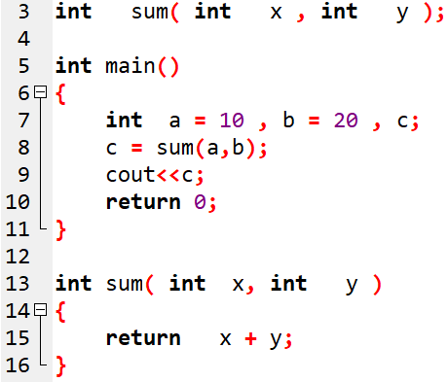

Slide 24
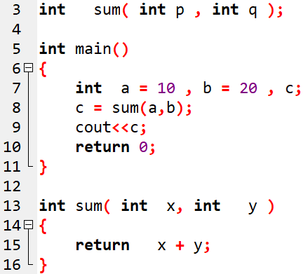

Slide 25
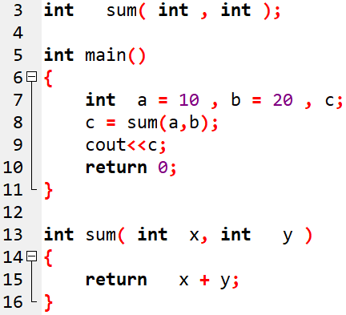

Slide 26
Functions- points to note
The parameter list must be separated by commas.
  dispChar( int n, char c);
The parameter names do not need to be the same in the prototype declaration and the function definition.
The types must match the types of parameters in the function definition, in number and order.
  void dispChar ( int n, char c);//proto-type
void dispChar ( int num, char letter) // function definition
{ cout<<" You have entered "<< n<< “&” <<c; }
Use of parameter names in the declaration is optional.
  void dispChar ( int , char);//proto-type

Slide 27
Functions- points to note
If the function has no formal parameters, the list is written as (void).
The return type is optional, when the function returns int type data.
The return type must be void if no value is returned.
When the declared types do not match with the types in the function definition, compiler will produce error.

Slide 28
Functions- Categories
Functions with no parameters and no return values.
Functions with parameters and no return values.
Functions with parameters and one return value.
Functions with no parameters but return a value.

Slide 29
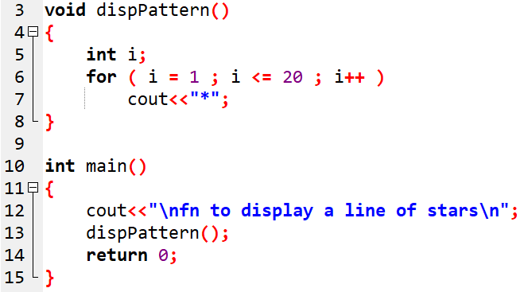
Fn with No parameters & No return values

Slide 30
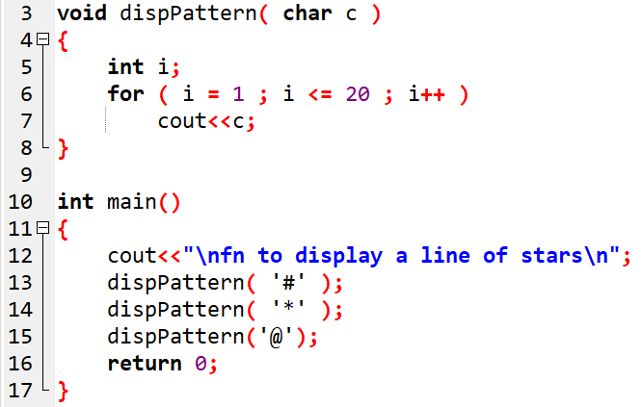
Fn with parameters & No return values

Slide 31
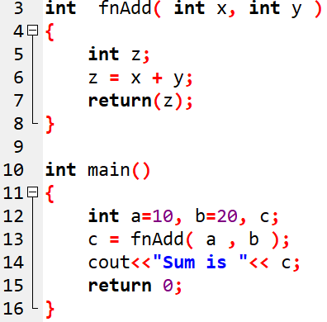
Fn with parameters & One return value

Slide 32
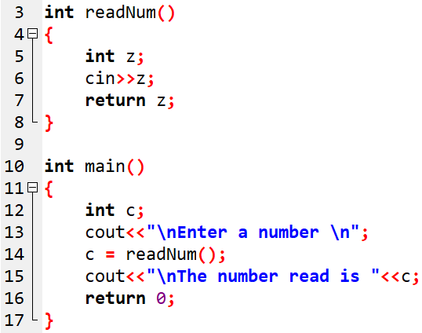
Fn with No parameters but A return value

Slide 33
To be solved …Functions
Write appropriate functions to
  Find the factorial of a number ‘n’.
  Reverse a number ‘n’.
  Check whether the number ‘n’ is a palindrome.
  Generate the Fibonacci series for given limit ‘n’.
  Check whether the number ‘n’ is prime.
  Generate the prime series using the function written for prime check, for a given limit.

Slide 34
Functions- Parameter Passing
Pass by value (call by value)
Pass by reference (call by reference)

Slide 35
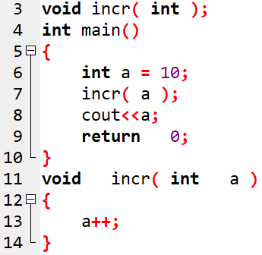

Slide 36
Question..
Write a function prototype for a function named test() that takes three arguments (two integer arguments, and a character argument), and returns a float value.
Ans: float test( int , int , char );

Slide 37
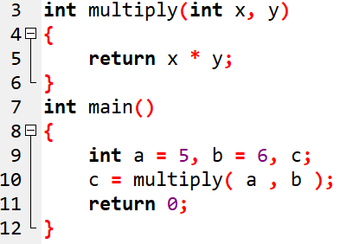
Questions..
2. What is the output of the following code?
Error !

Slide 38
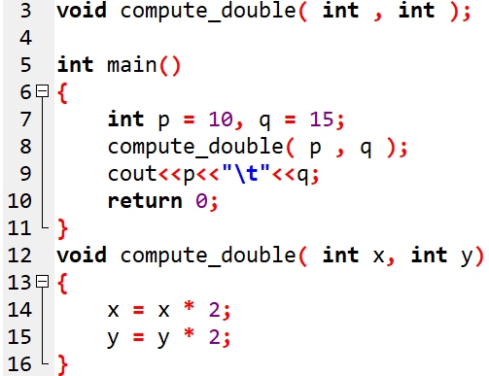
Questions..
3. What is the output of the following code?

Slide 39
Functions- Parameter Passing
Pass by value (call by value)
Pass by reference (call by reference)

Slide 40
Reference variable
A reference variable is an alias, that is, another name for an already existing variable.
Once a reference is initialized with a variable, either the variable name or the reference name may be used to refer to the variable.
Syntax:
Datatype & RefVariable = valVariable;
Example: int &r = i; // i declared earlier

Slide 41
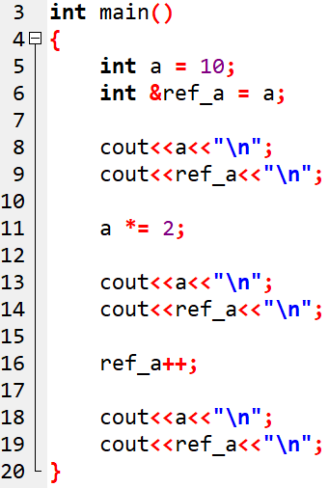
OUTPUT

Slide 42
C++ References vs Pointers:
Three major differences between references and pointers are:
You cannot have NULL references. You must always be able to assume that a reference is connected to a legitimate piece of storage.
Once a reference is initialized to an object, it cannot be changed to refer to another object. Pointers can be pointed to another object at any time.
A reference must be initialized when it is created. Pointers can be initialized at any time.
Datatype & RefVariable = valVariable;

Slide 43
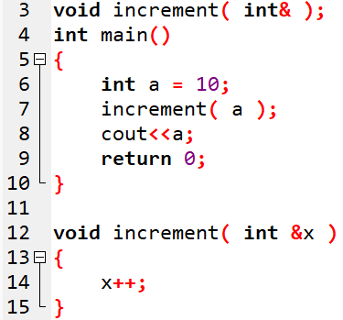
OUTPUT

Slide 44
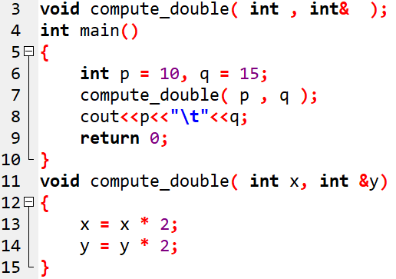
OUTPUT

Slide 45
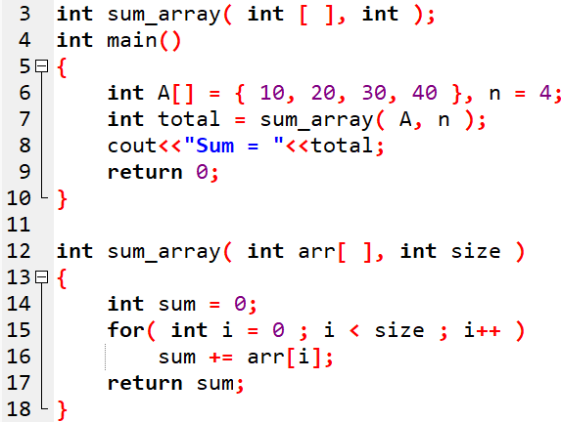
Passing 1D-Array to a function
Notes:
the array_name contains the address of the first element. [[[return_type function(type *arrayname) ]]]
Returning array from the function--→ a function can not return more than one value.
https://www.javatpoint.com/passing-array-to-function-in-c
***To make a function returning an array, the following syntax is used.
int * Function_name() {
//some statements;
return array_type;
}

Slide 46
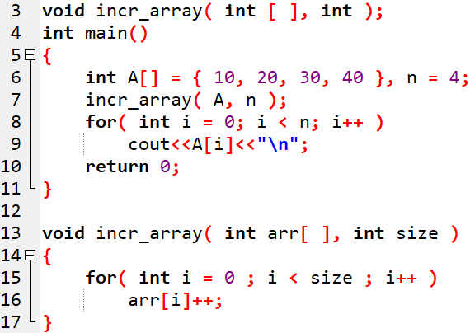
Notes:
the array_name contains the address of the first element

Slide 47
Passing 1D-Array to Function
Rules to pass an array to a function
The function must be called by passing only the name of the
array.
In the function definition, the formal parameter must be an
array type; the size of the array does not need to be
specified.
The function prototype must show that argument is an array.

Slide 48
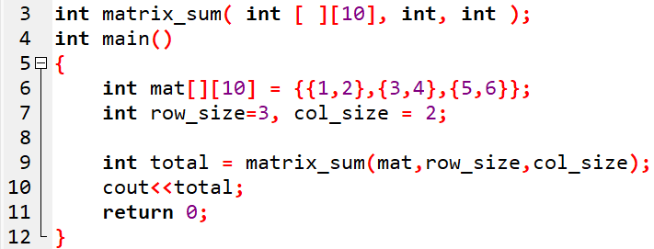
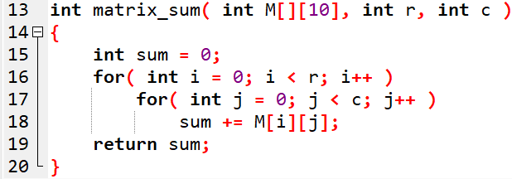
Passing 2D-Array to Function

Slide 49
Passing 2D-Array to Function
Rules to pass a 2D- array to a function
The function must be called by passing only the array name.
In the function definition, we must indicate that the array has
two-dimensions by including two set of brackets.
The size of the second dimension must be specified.
The prototype declaration should be similar to function
header.

Slide 50
Function overloading, default arguments and inline functions

Slide 51
Function Overloading
Using the concept of function overloading - we can design a family of functions with one function name but with different argument lists.
The function would perform different operations depending on the argument list in the function call.

Slide 52
Example
void display ( int );
void display ( long );
void display ( char [ ] );
void display( int var )
{
cout<<var<<endl;
}
void display( long var )
{
cout<<var<<endl;
}
void display( char var[ ] )
{
cout<<var<<endl;
}

Slide 53
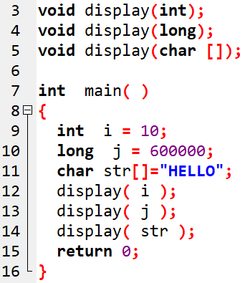
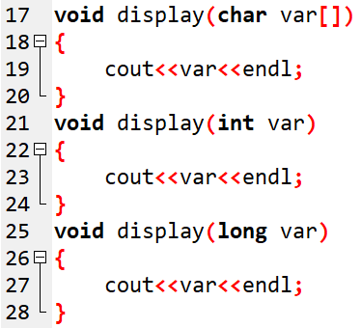

Slide 54
Default arguments
Default values are given in the function prototype declaration.
Whenever a call is made to a function without specifying an argument, the program will automatically assign values to the parameters
Only the trailing arguments can have default values and therefore we must add defaults from right to left.
We cannot provide a default value to a particular argument in the middle of an argument list.
Notes:
54

Slide 55
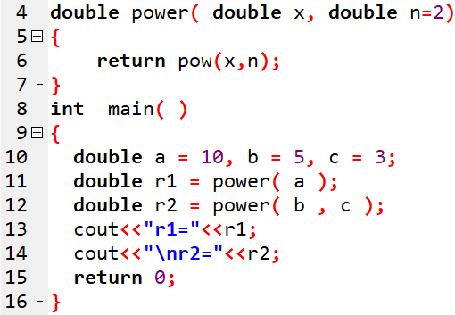

Function with default arguments - Example
OUTPUT

Slide 56
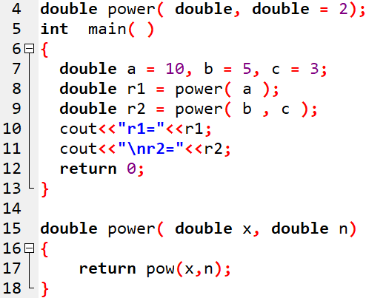
Function with default arguments - Example-1
OUTPUT

Slide 57
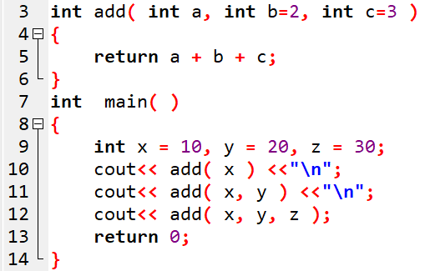
Function with default arguments - Example-2
OUTPUT

Slide 58
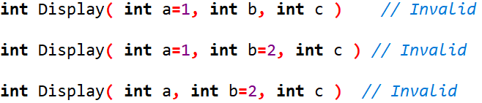

Slide 59
Inline functions
An inline function is a function that is expanded in line when it is invoked(or called).
The compiler replaces the function call with the corresponding function code (similar to the macros expansion).

Slide 60
The inline functions are defined as follows:
inline function-header
{
Function body
}
Example:
inline double cube( double a )
{
return a*a*a;
}
The above inline function can be invoked by statements like
double c = cube(3.0);
double d = cube( 2.5+1.5 );

Slide 61
All inline functions must be defined before they are called.
It is easy to make a function as inline function. Just prefix the keyword inline to the function definition.
The inline expansion makes a program run faster because the overhead of a function call and return is eliminated.
However, it makes the program to take up more memory because the statements that define the inline function are reproduced at each point where the function is called.

Slide 62
inline float mul ( float x, float y )
{
return x*y;
}
inline double div ( double p, double q )
{
return p/q;
}
int main()
{
float a = 12.5;
float b = 10;
cout << mul(a,b)<<”\n”;
cout << div(a,b)<<”\n”;
  return 0;
}

Slide 63
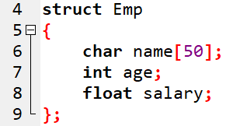
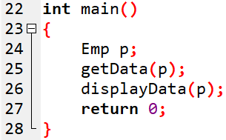
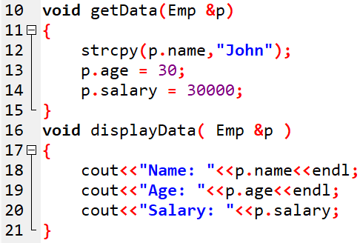

Passing structure to a function

Slide 64
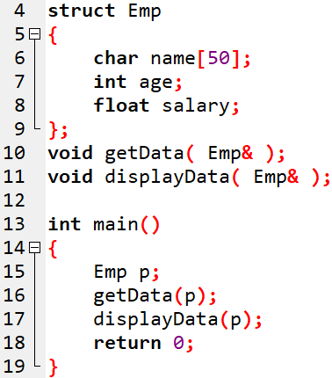
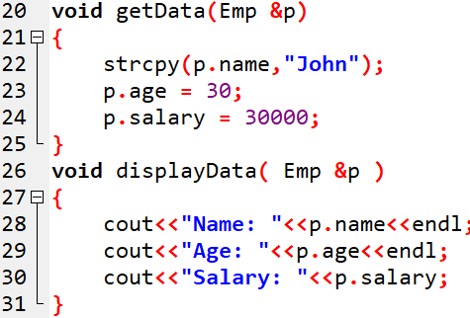
Passing structure to function

Slide 65


Recursion
Recursion is the property that when a called function calls themselves.
It is useful for many tasks, like sorting or calculate the factorial of numbers.
For example, to obtain the factorial of a number (n!) the mathematical formula would be:
n! = n * (n-1) * (n-2) * (n-3) ... * 1//recurrence formula
more precisely, 5! (factorial of 5) would be:
5! = 5 * 4 * 3 * 2 * 1 = 120
Notes:
65

Slide 66
Factorial
long int factorial (long a)
{
if (a ==0)
return 1;
return (a * factorial (a-1));
}
long fact = factorial (number);
Notes:
66

Slide 67

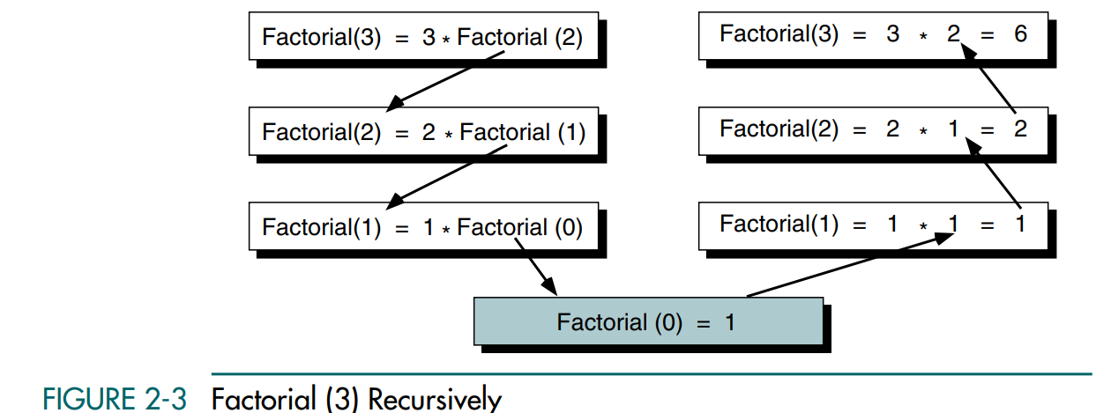
Slide 3
Factorial: Recursive Definition.

Slide 68
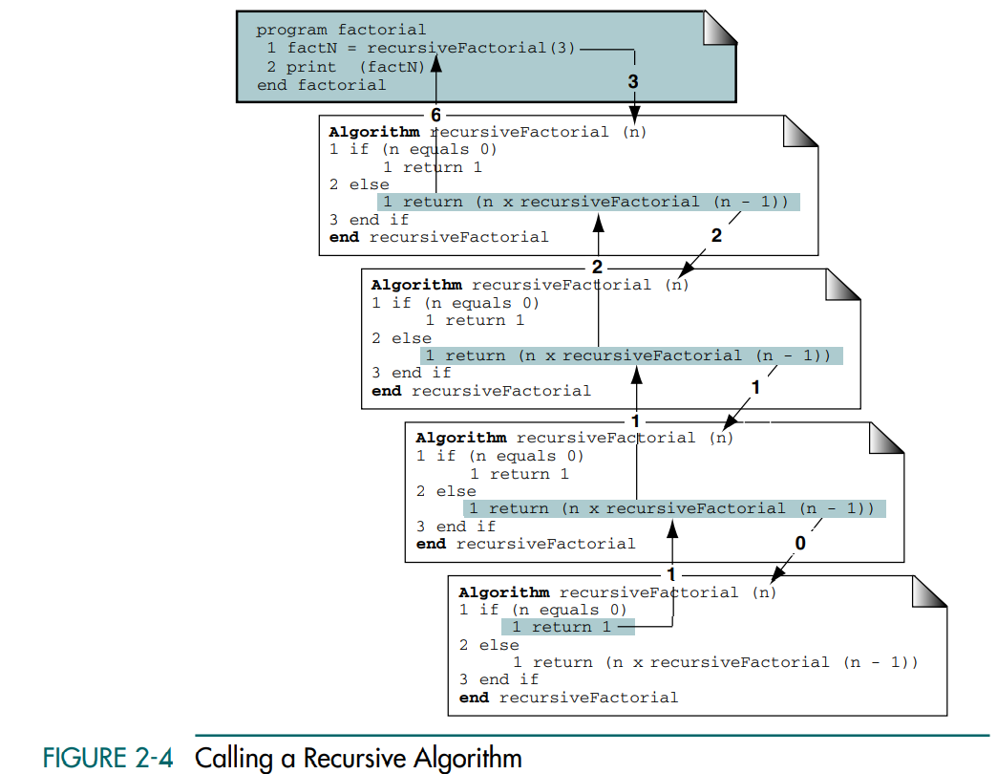
Slide 4
Recursive Solution Analysis
Figure 2-4 traces the recursion and the parameters for each individual call.

Slide 69
long int factorial ( long a )
{
if (a ==0)
return (1);
return (a * factorial (a-1));
}
long fact = factorial( 5 );
Notes:
69

Slide 70
long int factorial ( long a )
{
if (a ==0)
return (1);
return (a * factorial (a-1));
}
long fact = factorial( 5 );
5* factorial(4)
Notes:
70

Slide 71
long int factorial ( long a )
{
if (a ==0)
return (1);
return (a * factorial (a-1));
}
long fact = factorial( 5 );
5* factorial(4)
4* factorial(3)
Notes:
71

Slide 72
long int factorial ( long a )
{
if (a ==0)
return (1);
return (a * factorial (a-1));
}
long fact = factorial( 5 );
5* factorial(4)
4* factorial(3)
3*factorial(2)
Notes:
72

Slide 73
long int factorial ( long a )
{
if (a ==0)
return (1);
return (a * factorial (a-1));
}
long fact = factorial( 5 );
5* factorial(4)
4* factorial(3)
3*factorial(2)
2* factorial(1)
Notes:
73

Slide 74
long int factorial ( long a )
{
if (a ==0)
return (1);
return (a * factorial (a-1));
}
long fact = factorial( 5 );
5* factorial(4)
4* factorial(3)
3*factorial(2)
2* factorial(1)
1*factorial(0)
1
Notes:
74

Slide 75
long int factorial ( long a )
{
if (a ==0)
return (1);
return (a * factorial (a-1));
}
long fact = factorial( 5 );
5* factorial(4)
4* factorial(3)
3*factorial(2)
2* factorial(1)
1*factorial(0)
1
1
Notes:
75

Slide 76
long int factorial ( long a )
{
if (a ==0)
return (1);
return (a * factorial (a-1));
}
long fact = factorial( 5 );
5* factorial(4)
4* factorial(3)
3*factorial(2)
2* factorial(1)
1*factorial(0)
1
1
1
Notes:
76

Slide 77
long int factorial ( long a )
{
if (a ==0)
return (1);
return (a * factorial (a-1));
}
long fact = factorial( 5 );
5* factorial(4)
4* factorial(3)
3*factorial(2)
2* factorial(1)
1*factorial(0)
1
2
1
1
Notes:
77

Slide 78
long int factorial ( long a )
{
if (a ==0)
return (1);
return (a * factorial (a-1));
}
long fact = factorial( 5 );
5* factorial(4)
4* factorial(3)
3*factorial(2)
2* factorial(1)
1*factorial(0)
1
6
2
1
1
Notes:
78

Slide 79
long int factorial ( long a )
{
if (a ==0)
return (1);
return (a * factorial (a-1));
}
long fact = factorial( 5 );
24
5* factorial(4)
4* factorial(3)
3*factorial(2)
2* factorial(1)
1*factorial(0)
1
6
2
1
1
Notes:
79

Slide 80
long int factorial ( long a )
{
if (a ==0)
return (1);
return (a * factorial (a-1));
}
long fact = factorial( 5 );
120
24
5* factorial(4)
4* factorial(3)
3*factorial(2)
2* factorial(1)
1*factorial(0)
1
6
2
1
1
Notes:
80

Slide 81
To be solved using recursive fns…
Write a recursive function to generate n^{th} Fibonacci term. Print first N Fibonacci terms using this function.
[Hint: Fibonacci series is 0, 1, 1, 2, 3, 5, 8 … ]
Write a recursive function to reverse a number.
Find GCD of two numbers.
(Ex: GCD of 9,24 is 3)
Write a function to sort a list of number.
81

Slide 82
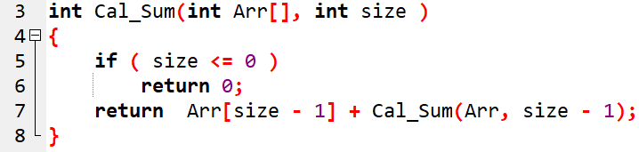
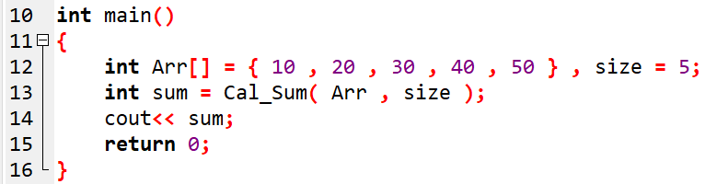
Question: Array sum using recursion

Slide 83
recursive calls working
Cal_Sum(Arr, 5)
= Arr[4] + Cal_Sum(Arr, 4)
= 50 + Cal_Sum(Arr, 4)
= 50 + 40 + Cal_Sum(Arr, 3)
= 50 + 40 + 30 + Cal_Sum(Arr, 2)
= 50 + 40 + 30 + 20 + Cal_Sum(Arr, 1)
= 50 + 40 + 30 + 20 + 10 + Cal_Sum(Arr, 0)
functions return back in reverse order:
Cal_Sum(Arr, 0) → 0
Cal_Sum(Arr, 1) → 10 + 0 = 10
Cal_Sum(Arr, 2) → 20 + 10 = 30
Cal_Sum(Arr, 3) → 30 + 30 = 60
Cal_Sum(Arr, 4) → 40 + 60 = 100
Cal_Sum(Arr, 5) → 50 + 100 = 150

Slide 84
Reversing a Number: Recursion
int rev(int num){
static int n = 0;
if(num > 0)
n = (n* 10) + (num%10) ;
else
return n;
return rev(num/10);
}
Output:
n = 234
rev = 432
84

